Slide 1
Lecture 4 Pumping & Minimization
Pumping Lemma
Nonregular languages and
Minimization of automata

Slide 2

Expansions of numbers
Natural numbers
½ is not a natural number
Rational numbers
is not a rational number
Algebraic numbers
e is not an algebraic number
Real Numbers
x^2=-1 does not have a root
Complex numbers
Regular
Languages
Regular language
Pumping Lemma

Slide 3
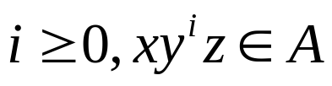


Pumping Lemma
If A is a regular language, then there is a number p (the pumping length) where, if s is any string in A of length at least p, then s may be divided into three pieces, s=xyz, satisfying the following conditions:
For each
, and
.

Slide 4
Proof Idea
s=s1 s2 s3 s4 s5 s6….sn string in A
q1 q3 q20 q9 q17 q9 q13 state
P is the number of states
y
x
q9
q1
z
q13
q9 is the first state that repeats

Slide 5
Proof steps
Proof by contradiction: B is nonregular
First assume the language B is regular and apply the pumping lemma to obtain the pumping length p
Next find a string s in B of length at least p which cannot be pumped.
Discuss s in several cases
So we arrive at a contradiction. Conclude that B is NOT regular

Slide 6
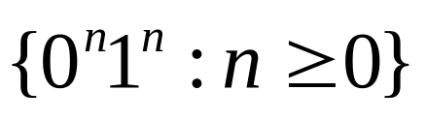
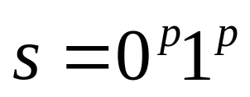
Example
Show that the language is not regular
Proof by contradiction: Suppose that it were regular. Let p be the pumping length given by the Pumping Lemma. Consider the string
y consists only of 0s;
Y consists only of 1s;
Y consists of both 0s and 1s.
We arrive at a contradiction. So it is not regular.
Discuss in cases

Slide 7
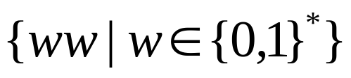
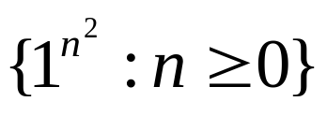
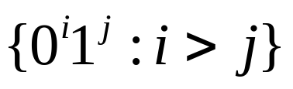
More examples
Prove that the following languages are not regular:
C={w|w has an equal number of 0s and 1s}.
F =
D =
E=
All proofs here are similar to show that the square root of 2 is not a rational

Slide 8
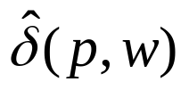
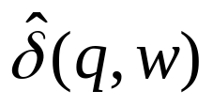
Equivalence
Given a DFA, two states p and q are equivalent if
For all input strings w, is an accepting state iff is an accepting state.
w
p
…..
q
w

Slide 9
Example
1
0
A
B
1
C
0
D
0
c
1
0
1
0
1
E
F
G
0
H
1
1
0
1
0

Slide 10
Table-filling algorithm (Where should we start?)
 | A | B | C | D | E | F | G | H
A
B | x
C | x | x
D | x | x | x
E |  | x | x | x
F | x | x | x |  | x
G | x | x | x | x | x | x
H | x |  | x | x | x | x | x

Slide 11
Testing equivalence of regular languages
Recall that
two DFAs are equivalent if they accept the same language.
Testing equivalence of DFAs can be transformed into testing equivalence of their starting states.
Can we do this in Kleene algebra?

Slide 12
Example: Two equivalent DFAs
0
1
start
A
1
B
What is the time complexity
0
start
C
0
D
0
0
1
1
It suffices to show that the starting
states are indistinguishable.
E
1
Exercise: Show this equivalence
in Kleene algebra.

Slide 13
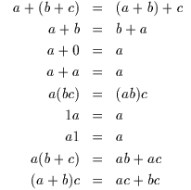

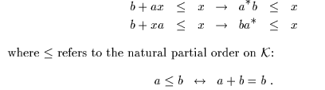
Kleene algebra: the algebra for regular expressions (by Dexer Kozen)

Slide 14
Minimization of DFAs
First eliminate any state that cannot be reached from the start state
The partition the remaining states into blocks so that all states in the same block are equivalent.

Slide 15
Minimization of DFAs: an example
1
0
G
1
D,F
1
A,E
0
0
0
B,H
C
1
1
Why is it minimal?
0

Slide 16
Testing equivalence of DFAs
First minimize automata A and A’ and get two minimal ones M and M’, respectively;
Check whether M and M’ are “isomorphic”.
How should we test the equivalence in Kleene algebra?

